Slide 1
More Ways to Use Your FSA or HSA
Understanding FSA/HSA Eligibility for Dual Purpose Items

Slide 2


Unlocking Additional Power of FSAs & HSAs
Primary Definition Eligible Medical Expenses
The IRS defines eligible medical expenses as costs primarily intended to diagnose, treat, or prevent a physical or mental illness.
Common Expenses Include:
Medical Services
Prescription medication
Medical equipment
Preventive care
Dental & vision care
Extended Definition Potentially Eligible Expenses
Non-traditional or dual purpose items may qualify if prescribed through a Letter of Medical Necessity (LMN) for the prevention or treatment of a specific condition for an eligible individual.
Potentially Eligible Expenses Include:
Fitness memberships and equipment
Supplements
Health tracking tools / apps
Notes:
[JUSTIN AND HILARIE]
Hilarie to review the definitions.
Justin to speak to how that translates at Truemed – in not salesy approach
Hilarie to speak to how Navia is leveraging it and what it hopes to gain
Compliance, education, etc – Hilarie to lead with initial commentary from Jessica and lead into case study.

Slide 3


What are Health Interventions? How do they work with traditional care?
Condition | Health Interventions | Traditional Healthcare
Obesity / Overweight | Fitness membership or equipment | GLP-1 / Weight-loss drugs
Diabetes / Pre-diabetes | Weight management Nutritional Supplements | Insulin Prescription medications
Chronic Sleep Issues | Exercise Red light therapy | Prescription medications CPAP
Chronic Joint Pain | Fitness equipment Foot insoles | Cortisone Injections Physical therapy
Explore over 3,000 merchants for potentially eligible items: Truemed.com/shop
Notes:
[JUSTIN TO WALK THROUGH THE DEFINITION AND EXAMPLES – HILARIE / JESSICA TO SPEAK TO IT AS COMPLEMENT TO TRADITIONAL CARE]

Slide 4
How Truemed Works
Notes:
[JUSTIN AND HILARIE]
Hilarie to review the definitions.
Justin to speak to how that translates at Truemed – in not salesy approach
Hilarie to speak to how Navia is leveraging it and what it hopes to gain
Compliance, education, etc – Hilarie to lead with initial commentary from Jessica and lead into case study.

Slide 5
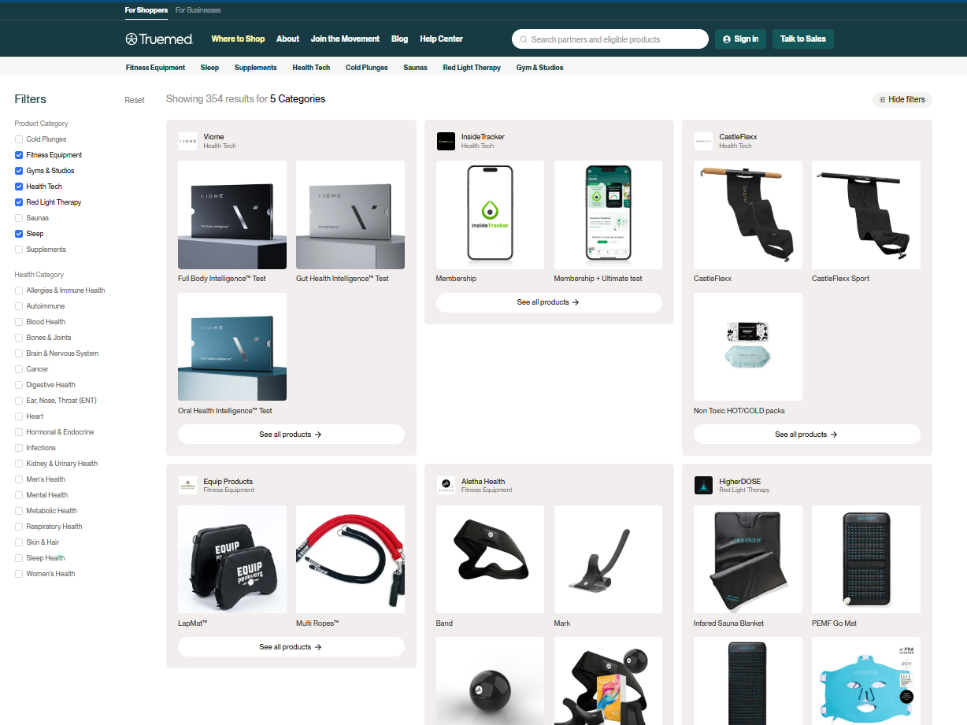
Truemed’s Marketplace for Health Interventions
Over 3,000 merchant partners
Search by condition or category
Item purchases are not finalized unless it is confirmed that an individual is eligible for an LMN

Slide 6
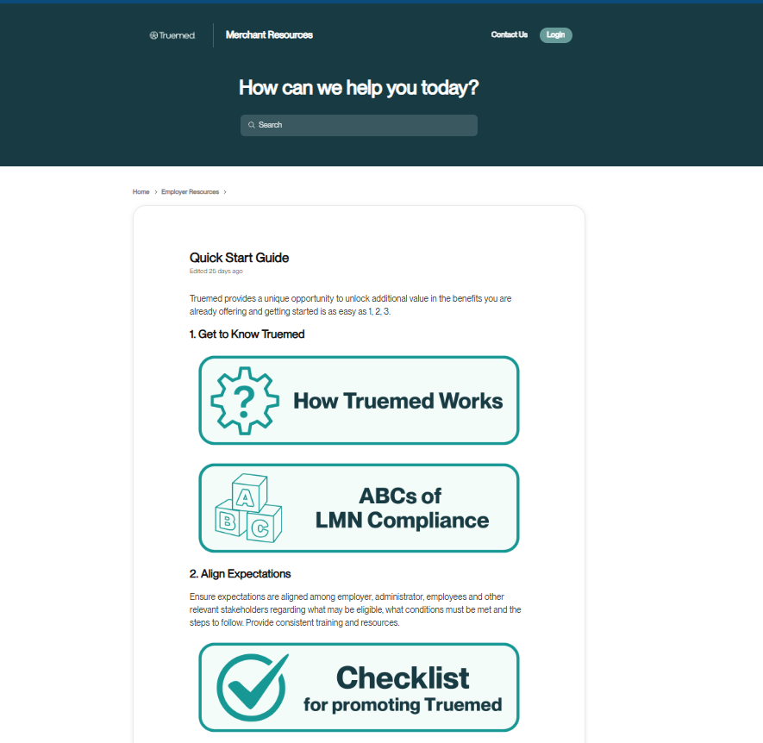
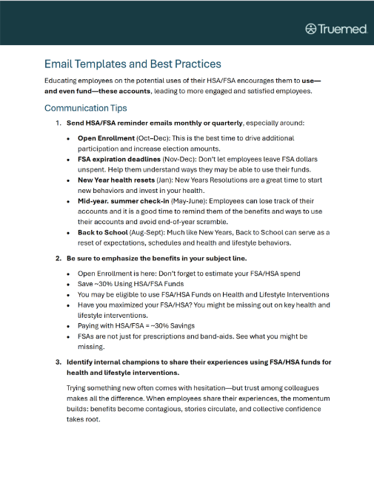
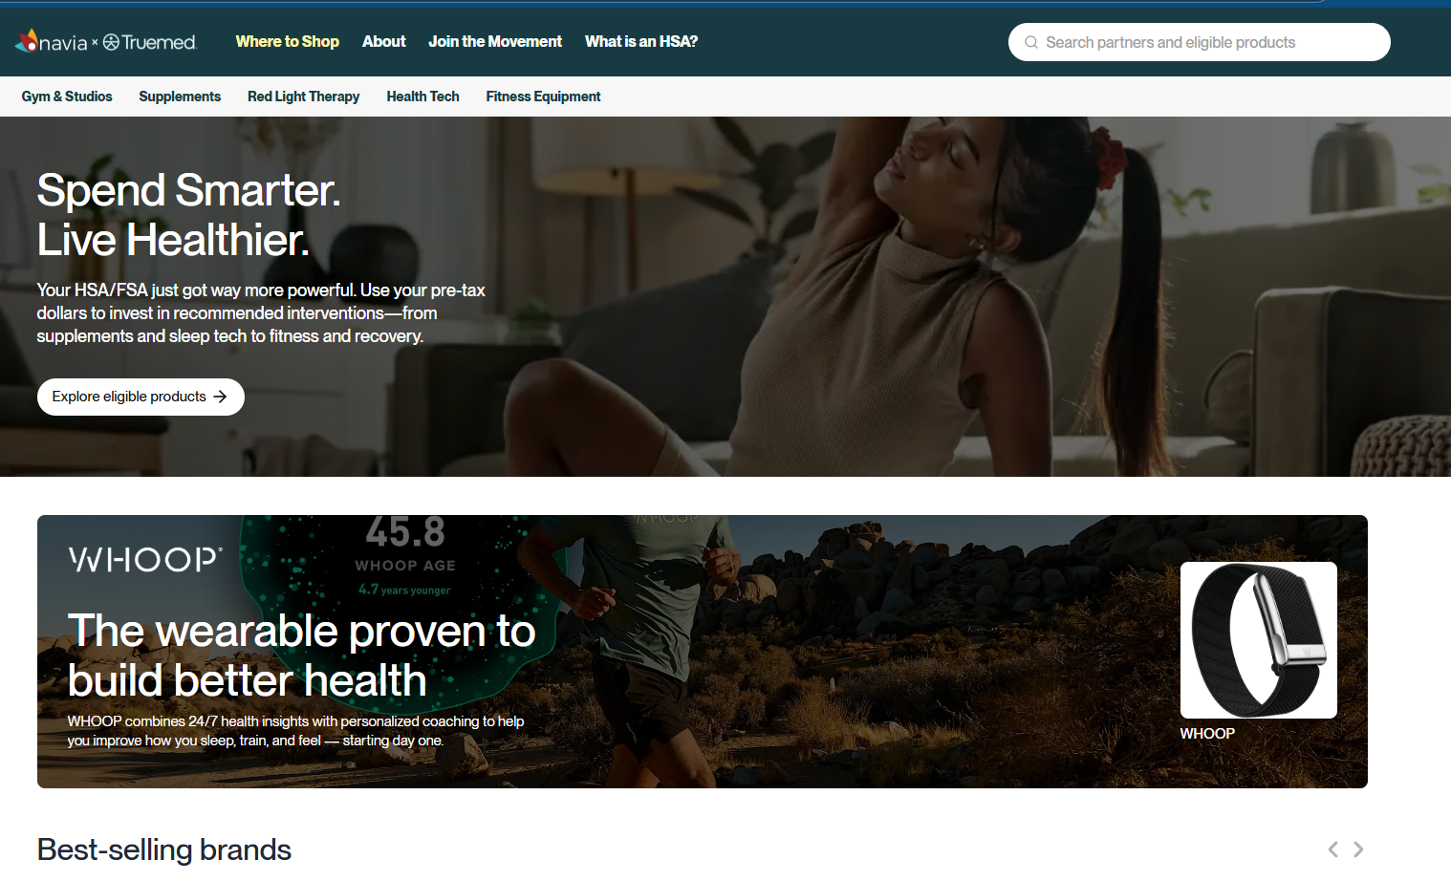
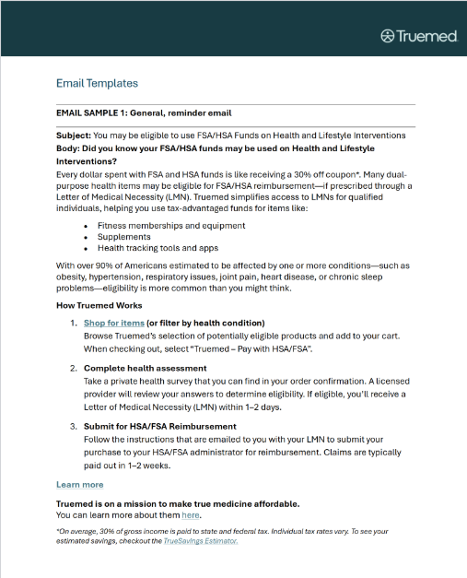
Partner and Employer Promotional Resources
Checklist and Best Practice Guide
Turnkey resources, including:
Email Templates
Content Snippets
Flyers
Banners

Slide 7
Integration Potential Eliminate documentation outreach and manual LMN review
Truemed integrates with administrators to:
Streamline substantiation through API and file exchange processes to systematically substantiate transactions
Automate claim submission for reimbursement when benefits card is not used for direct payment.

Slide 8



Case Study – The Krazy Coupon Lady (KCL) How FSA Participation increased by 36%
KCL’s mission is to teach people how to shop smarter.
Committed to uncovering savings (for employees and followers).
The Problem
The Solution
KCL partnered with Truemed to:
Eliminate the friction in the LMN process
Open new doors for FSA/HSA use
Health and Lifestyle Interventions can feel inaccessible and require a Letter of Medical Necessity (LMN) to be eligible for reimbursement from FSA/HSA.
Traditional processes to obtain an LMN tend to be complicated, slow, misunderstood and potentially costly – discouraging most people from using it.
Notes:
JESSICA TO LEAD

Slide 9

Case Study – KCL How FSA Participation increased by 36%
The Results
Key Benefits to Employees
By reducing friction and expanding benefit usability KCL realized:
FSA participation increased 36%
Average employee contribution rose 27%
Increased estimated tax savings
For employee =$334 (up $100)
For employer = $120/EE (up $25)
Broadened eligibility
Streamlined process
Seamless experience
Increased tax savings
No cost to employees, no barriers, just empowerment
Key Benefits to KCL
Better Health Outcomes: Proactive health investments reduce claims, absenteeism, and improve morale.
Tax Savings: Average annual payroll tax savings of $120 per participating employee.
Support employee well-being with meaningful, modern tools
Notes:
JESSICA TO LEAD

Slide 10
Why Truemed?
Largest Selection of Health & Lifestyle Interventions Over 3,000 merchant partners providing comprehensive and cost-effective options for eligible individuals.
Health Interventions are Evidence-backed and Reviewed All items and services are backed by evidence-based research and reviewed by advisory committee
Eligibility is Reviewed Individually Eligibility for a Letter of Medical Necessity is not automatic. Individuals complete a health assessment which is reviewed by licensed clinicians to determine eligibility.
Streamline Processing Truemed provides options for systematic data exchange to help reduce or eliminate manual processing of LMNs.
Powered by Compliance-Centric Process Over the last two years, we have worked closely with the IRS and industry experts to understand and adapt our processes to ensure alignment with FSA and HSA acceptance rules

Slide 11



Will you unlock the value of HSAs/FSAs?
Contact Tom Dahl
tom@truemed.com
Truemed.com
linkedin.com/company/truemedpayments

